Slide 1
Hi
Notes:
Good afternoon everyone. To explore the beauty of the world, one thing we all do: that is ”We travel”. Will you be curious, If you can get the information about historic places and point of interests that you can see through the vehicles window when you travel? What about those information what resides outside the vehicles window? Today , together with my two colleagues, I am going to introduce you an innovative and exciting idea which we believe can bring an extra-ordinary impact to the travel industry. But first, i would like to introduce myself.

Slide 2

SEA Quasar
Abdullah Al Noman
CEO
Notes:
This is Abdullah al Noman, CEO of SEA Quasar. Six months ago we came up with an idea to and worked very hard to make the dream come true.

Slide 3
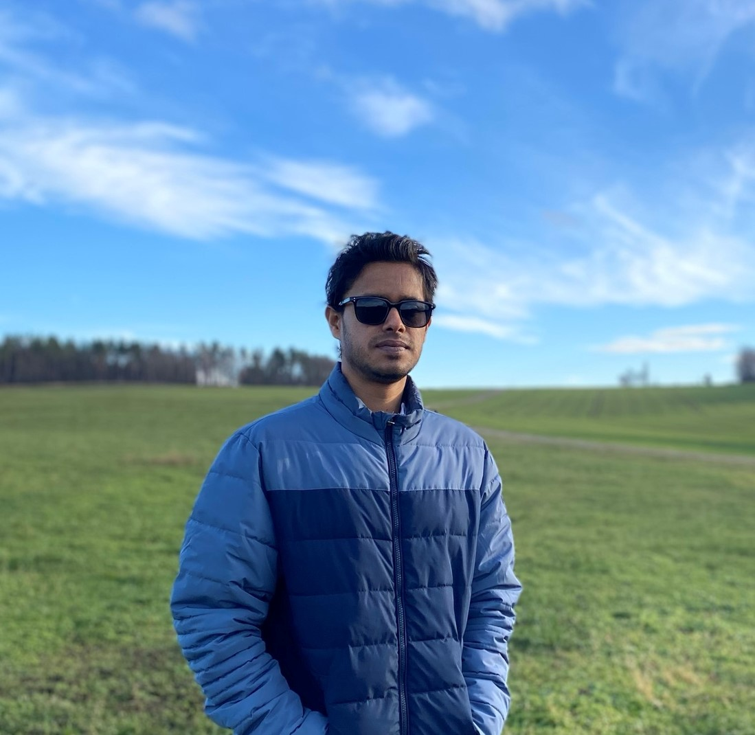
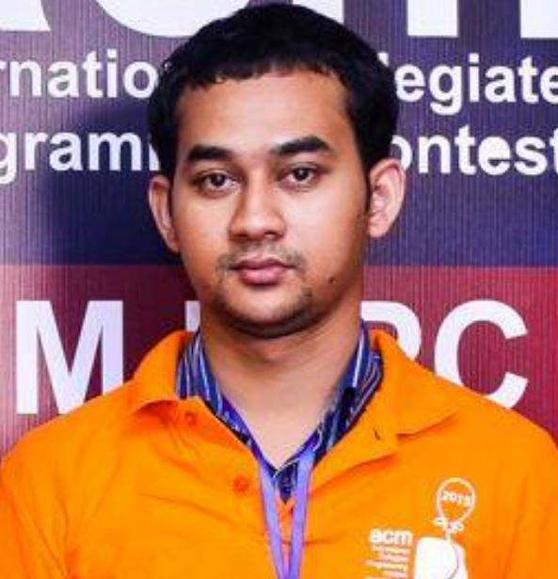

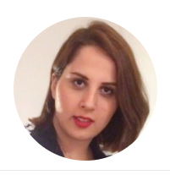
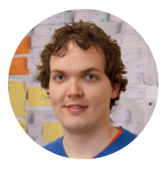
Abdullah Al Noman
CEO
Md Atikul Islam
CTO
Emon Hossain
CFO
Mahda Noura
Advisor
Valentin Siegert
Advisor
Notes:
Behind every successful story there is always some skilled personnel who give their best to make that happen. We are the power source of SEA Quasar. Alongside with me, Emon Hossain is the Chief Finance Officer and as our chief Technology officer Md atikul islam are working dedicatedly to deployed the new idea.To make the idea work, we are getting continuous guidelines and suggestions from our two extra ordinary advisors Mahda Noura and Valentin Siegert who are one of the key people of VSR team of Chemnitz University of Technology.

Slide 4
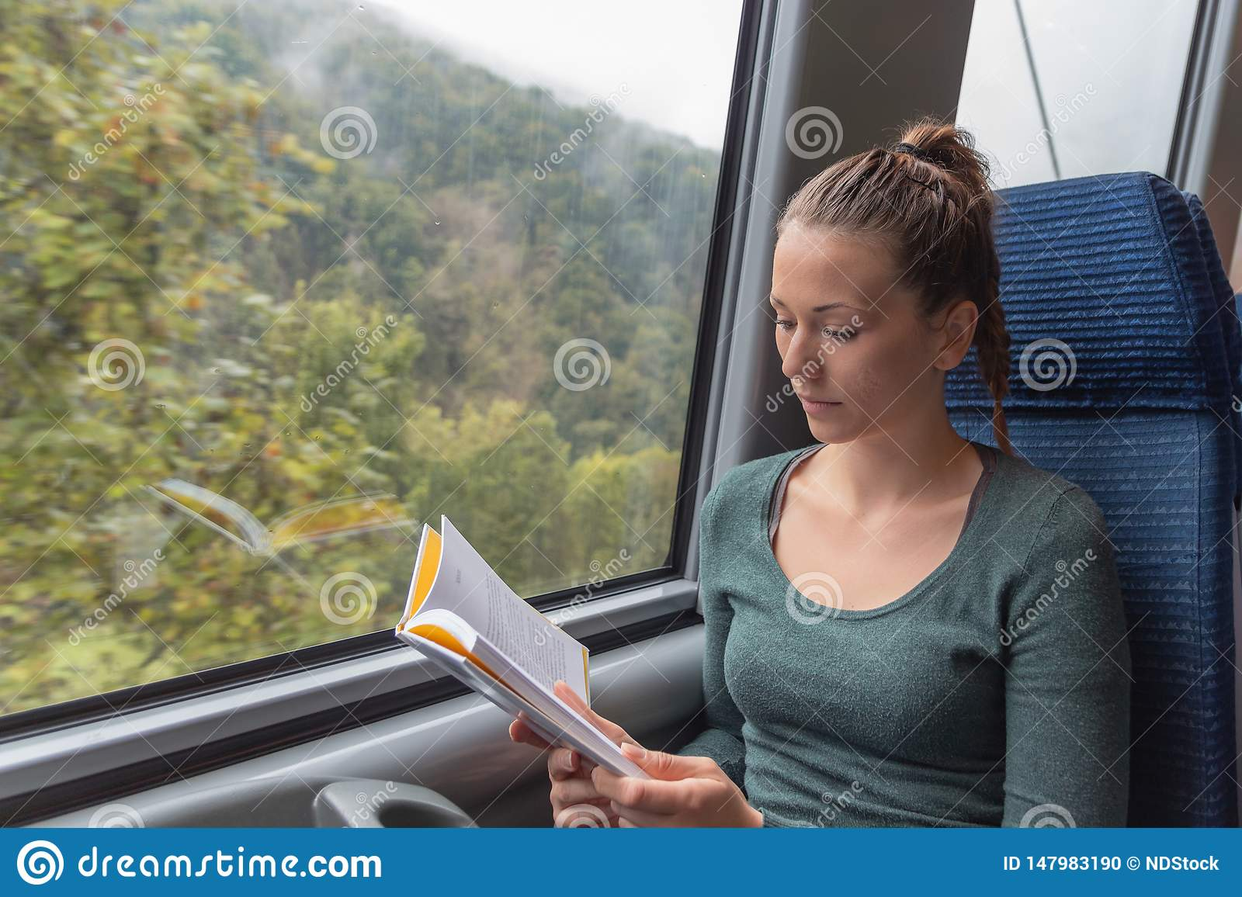
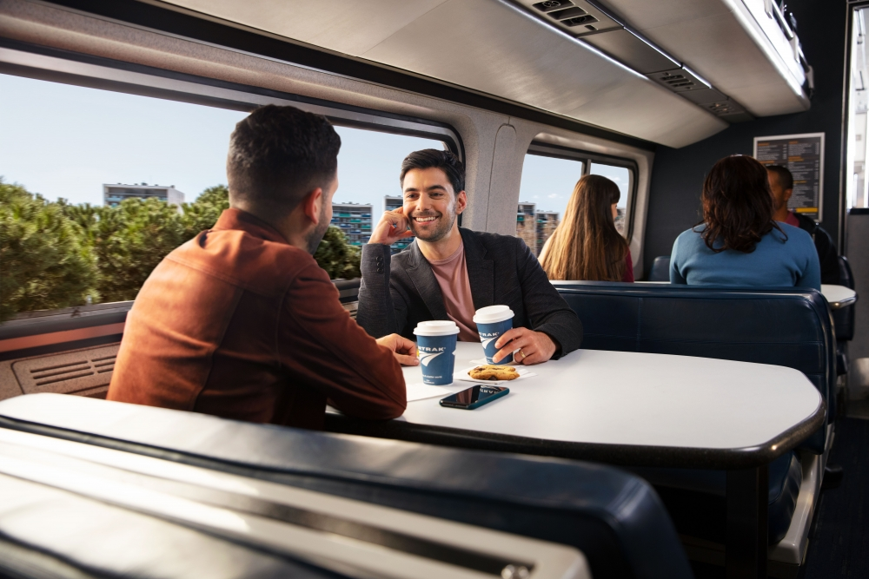

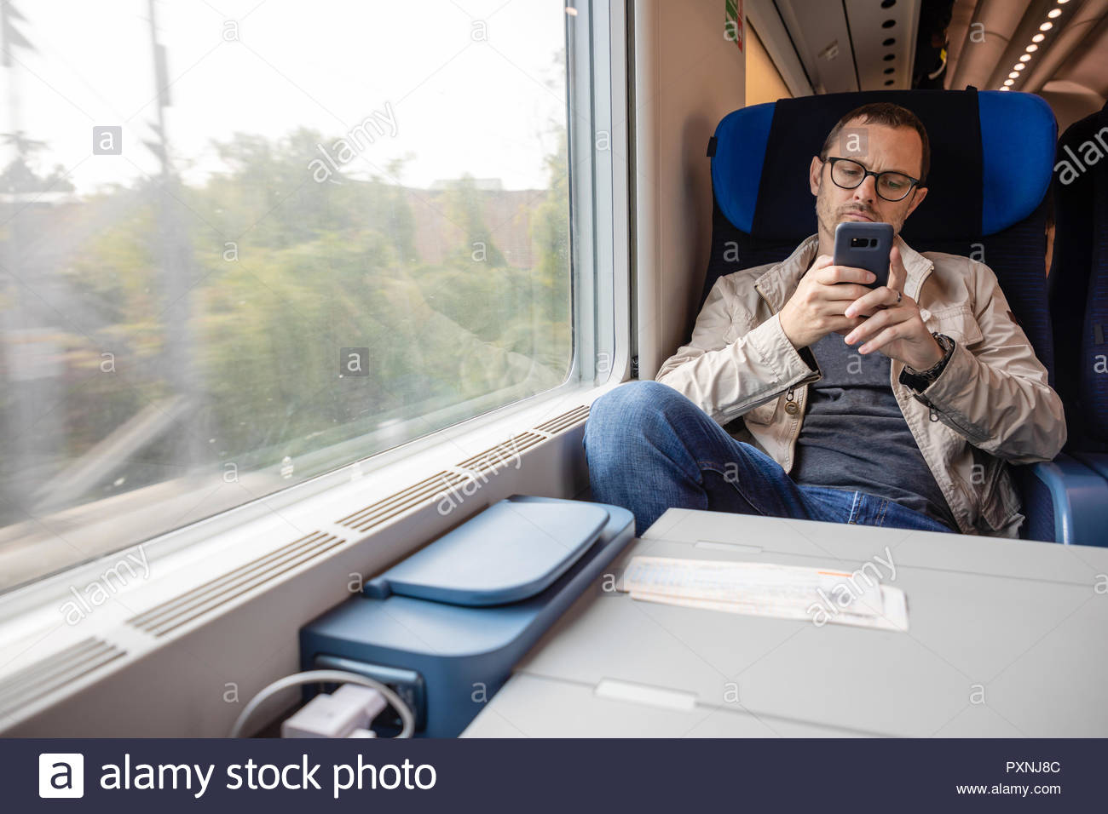
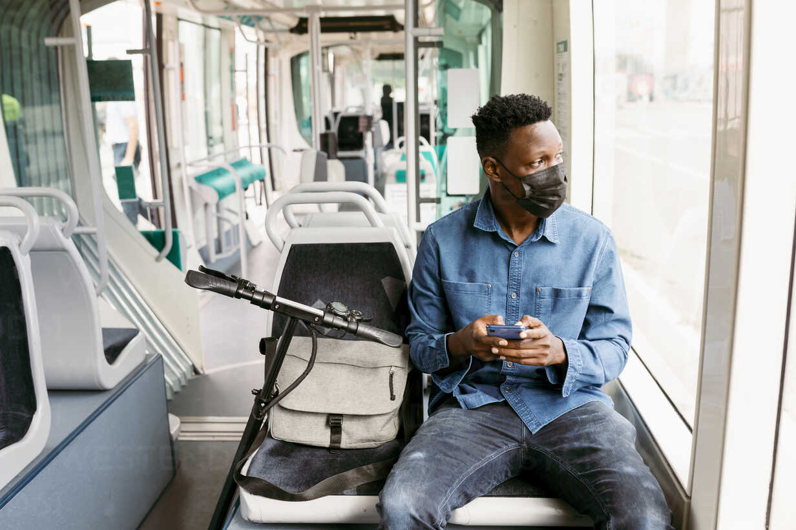
Notes:
Transportation industry is a huge sector to work on. There are lot of aspect for everyone to do business on this sector. People travel to explore new things in their own way. But one thing is always common when they travel from one place to another. They need a ride. We are focusing those who choose public transport : Train and Bus to travel. Usually until they reach their destination they remain seated in the vehicle.
While traveling people usually read books or newspapers, listen to music, play with phones or enjoying outside views. Of course travelers can do what they love most. But on this era, we are surrounded by technologies. Our idea is to introduce a new technology to let them know about geographical, historical and cultural information of the area they are travelling through. Now the question arise How can we do that? To make an informative journey we thought what will be best way to communicate with the passengers or travelers?

Slide 5
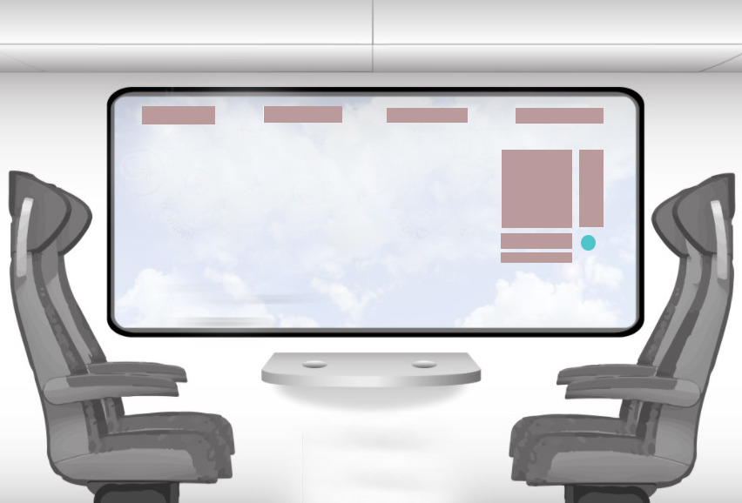
Notes:
We chose the glass window of the vehicle to act like a transparent interactive display. We want to display information on the vehicle’s window what a traveler sees on his/her own eyes through the window. Which will include historical places, monuments, castles, statues etc commonly known as point of interest. Seating on a public transport for hours, passengers now have the opportunity to explore those information around the area they are passing through. Our key focus here is to provide authentic information about mentioned items and generate more curiosity among travelers. Because curiosity of information has brought us in a different level where exploring new thing is always exciting.
We are calling it Smart window which is a collective visual passenger information service.

Slide 6
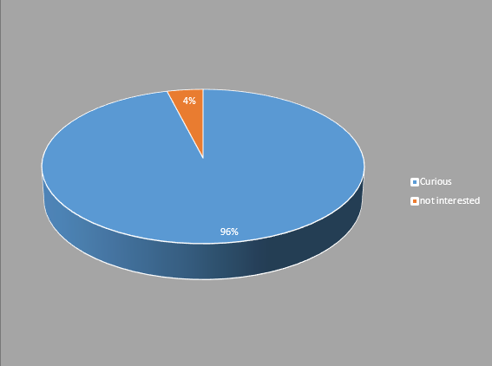
Notes:
To make our idea successful, We have done a market survey asking one major question “would you like to see relative information about things that may raise a question on your mind “WHAT’S THAT?” while traveling on the window of a train or bus”? The feedback was mind-blowing. 96% people was curious about it. Those travelers who usually choose their own private transportation, they are also very keen to explore cities through smart window. This enormous response boost our work and we have done a lot of market research of how we can make it work.

Slide 7
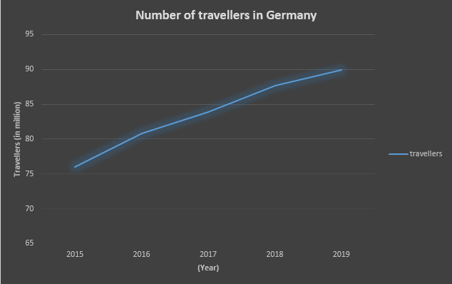
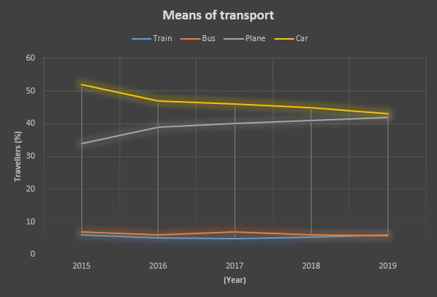
Notes:
From 2015 to 2019, We have found the number of travelers has increased gradually but the percentage of public transport user has not increased as expected and least number of people was the user of bus and train as their transportation medium when they travel to make vacations.
For those years the percentage of travelers who used public transport(Train and bus together) were between 11- 13% of total travelers. Based on our market research we are forecasting to increase that percentage to 20% minimum. We believe the number of public transport user will increase 3 million more in a calendar year. I believe This significant growth will have a tremendous impact on the companies who will deploy Smart window onto their vehicles.
Are you curious? Now, I would like to invite our Chief Technology Officer Md Atikul Islam to present a demonstration and show us a glimpse of our smart window.

Slide 8
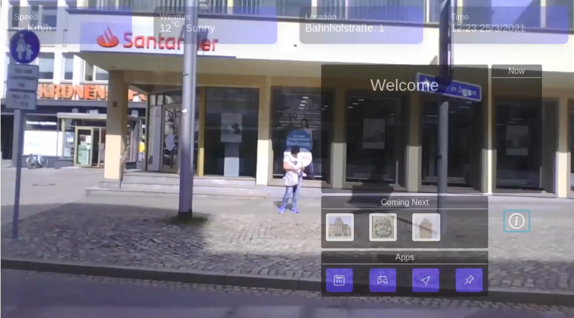

Slide 9
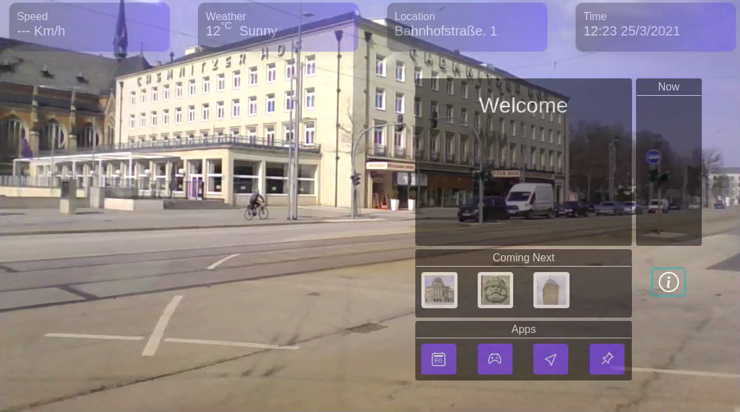
Notes:
Here is our beautiful User Interface. This is exactly, What the travelers will see. On the top of the display we are providing general information such as weather, time, location, And vehicle speed. A GPS based speedometer will be integrated on the vehicle. To display information regarding point of interest there are three panel. The bigger panel among others is the main focus area and displays most of the information like point of interest, entertaining activities, direction. The panel of the right side will be used as currently found point of interest it will be used as a queue. Below the main panel is the area which will be used to display upcoming point of interests. Apart from point of interest, The smart window also have some other features depending on the user request. The last one is for applications panel. Passengers will be able to use various application throughout the entire travel duration.

Slide 10
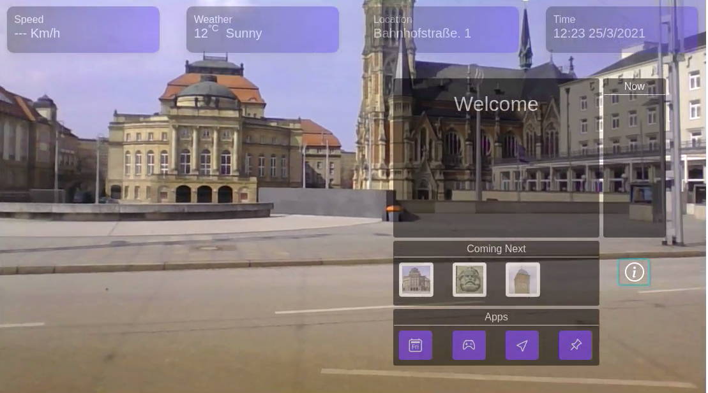
Notes:
At this point, as a passenger I can see a structure that seems interesting and I saw that very building is in the coming next panel. As a passenger, Normally being curious about the building yet no information is known.

Slide 11
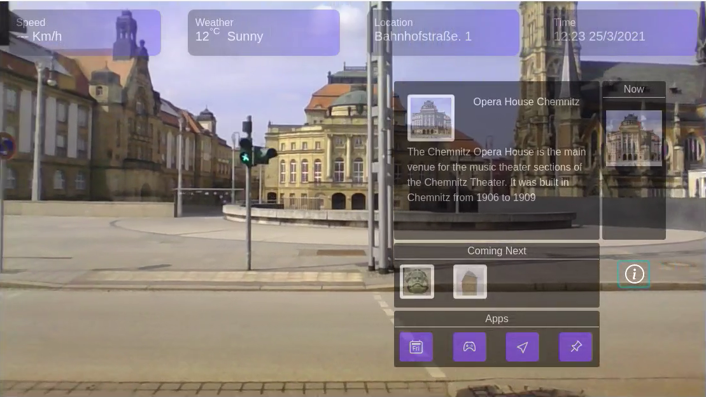
Notes:
Wow!! The window has just read my mind. I am curious and now I can see the information I wanted to know. It’s amazing .

Slide 12
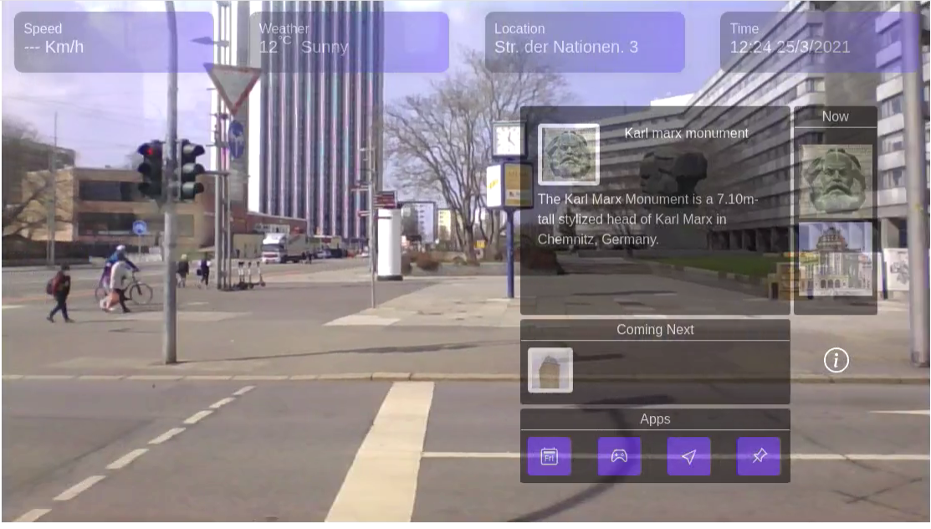
Notes:
Leaving behind the opera house the vehicle is now in front of the karl-marx which is another point of interest and information about it is also showing on the window. karl-marx is our current point of interest now. Instead of showing it on coming next panel, It is now in the queue panel and the opera house is in the second position. Which can be viewed again by touching on the image. By touching on the coming next panel, passengers of the train can see the upcoming point of interest.

Slide 13
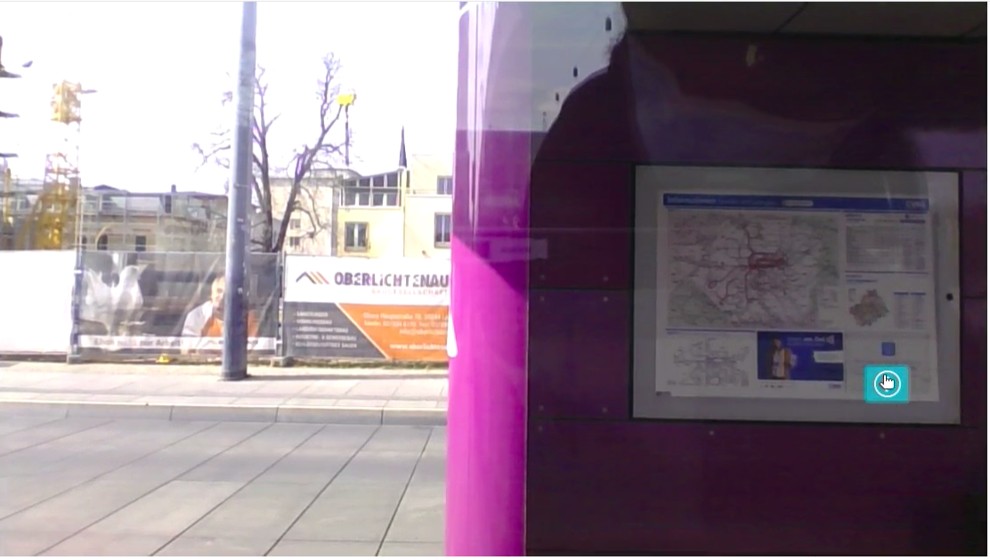
Notes:
Passengers can hide and show the UI by clicking on only one button. The information icon will do that for you.
Our CFO Emon Hossain believes, A good business approach can make an idea more successful. I would like to invite him to tell us about our financial strategy.

Slide 14

How will we make money ?
Notes:
Thank you atik for your demonstration. now its time to make money out of it. This was big question for me to find out how will we make money? probably the most important question ever, isn't it ?
More than 16 thousand trains and 80 thousand buses operate in Germany. We are targeting to deploy at least 1000 unit every year which is only 1% of the total number of vehicles in the country. You may think why we are targeting too low? When the target market is very vast, bringing a new technology requires steadiness. Focusing “Slow and steady wins the race”. We will add new information and make continuous changes to attract more travelers which will drag our clients to deploy more. We can expect at least a gentle growth every year together with the targeted 1%. If we can drag the percentage of public transport user to 20% in a year, that would be our the first achievement. It will definitely generate a good market domination.
We are offering a very attractive and easily affordable price for our customers. A single unit will be 3000 Euros and an Annual Maintenance cost(AMC) will be 600 euros up to 5 years. After 5 years if our clients require further support, we will make new arrangement.

Slide 15




Notes:
Apart of the software, we have a big dependency on hardware. To become the best in the market we need a qualitative, durable and an interactive display window. We have officially sent a proposal to these companies with our expected price, quantity in a year and all the specifications we are looking for. We have received an exciting and fast responses from them. with our collaboration very soon we want to start our final integration.

Slide 16



Notes:
We have some formidable competition in the space we’re in right now. We have already looked at the strengths and weaknesses of each one of them and I can assure you that we have a strong advantage in highly skilled manpower, unique market approach and superior product. Combination of these three will make a strong root in the transportation industry.

Slide 17
Financial Overview (in million)
 | 1st year | 2nd year | 3rd year | 4th year | 5th year
Revenue | 3.6 | 7.8 | 12 | 16.2 | 20.4
Expenses | 2.7 | 5.2 | 7.7 | 10.2 | 12.7
Net Income | 0.9 | 2.6 (Break Even) | 4.3 (Profitability) | 6 | 7.7
Notes:
We are dedicated to invest 200 thousand to develop our software and to make our company functional. Our projection is to deploy 1000 smart windows in a calendar year which will require hardware manufacturing and implementation on the vehicles.
With a target to deploy at least 1000 windows in a year, we are expecting to reach at break even point after end of second year December post funding and after third year December post funding we expect to be profitable.

Slide 18
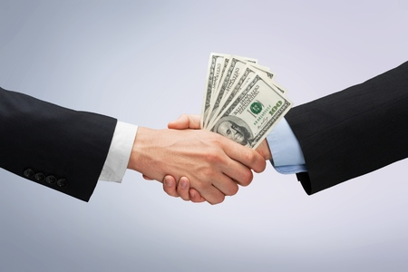
Notes:
Focusing on our financial overview, we would like to ask for an investment of 2.5 million euros.

Slide 19
SEA Quasar
E-mail – info@seaquasar.de
Phone – 017658869381
Web – www.seaquasar.de
Reichenhainer Str. 51
09126, Chemnitz, Germany
Notes:
Now in the end i would like to thank you for your patience. we are looking for your feedback ,if you are curious and want to know more about us and our product, we would be happy to make an appointment with you. you can reach us simply by dialing or through email.

